Slide 1
Software Project Management
SE- BSCS V- FALL 2017

Slide 2
Project Management Applications
What is a project?
  Any endeavor with objectives
  With multiple activities
  With defined precedent relationships
  With a specific time period for completion
Examples?
  A major event like a wedding
  Any construction project
  Designing a political campaign

Slide 3
Five Project Life Cycle Phases
Conception: identify the need
Feasibility analysis or study: costs benefits, and risks
Planning: who, how long, what to do?
Execution: doing the project
Termination: ending the project

Slide 4
Network Planning Techniques
Program Evaluation & Review Technique (PERT):
  Developed to manage the Polaris missile project
  Many tasks pushed the boundaries of science & engineering (tasks’ duration = probabilistic)
Critical Path Method (CPM):
  Developed to coordinate maintenance projects in the chemical industry
  A complex undertaking, but individual tasks are routine (tasks’ duration = deterministic)

Slide 5
Both PERT and CPM
Graphically display the precedence relationships & sequence of activities
Estimate the project’s duration
Identify critical activities that cannot be delayed without delaying the project
Estimate the amount of slack associated with non-critical activities

Slide 6
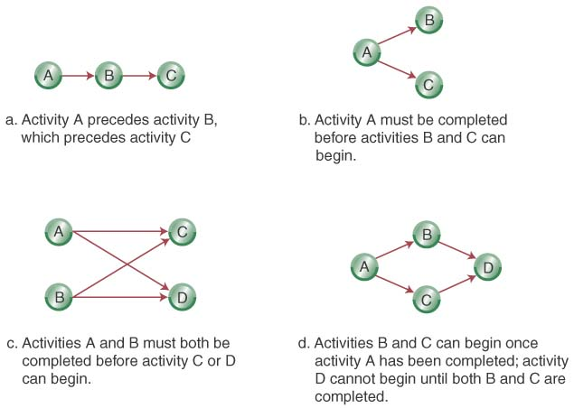
Network Diagrams
Activity-on-Node (AON):
  Uses nodes to represent the activity
  Uses arrows to represent precedence relationships

Slide 7
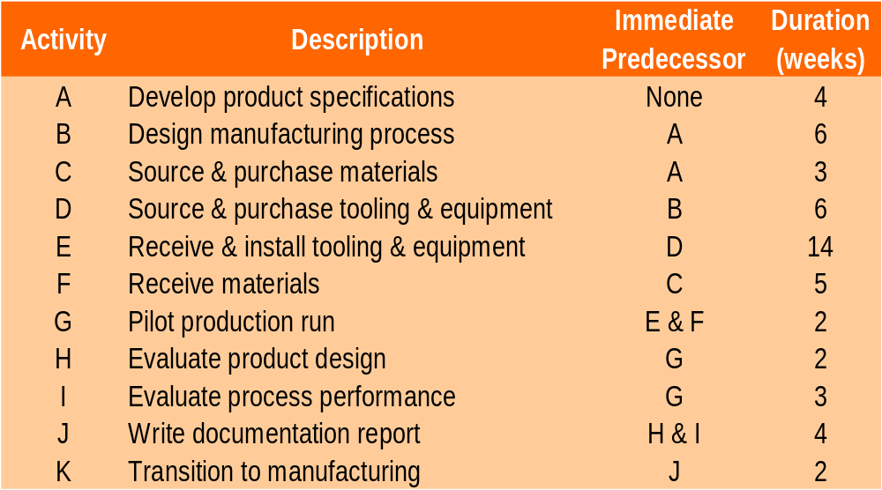
Step 1-Define the Project: Cables By Us is bringing a new product on line to be manufactured in their current facility in some existing space. The owners have identified 11 activities and their precedence relationships. Develop an AON for the project.

Slide 8
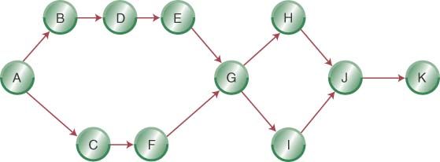
Step 2- Diagram the Network for
Cables By Us

Slide 9
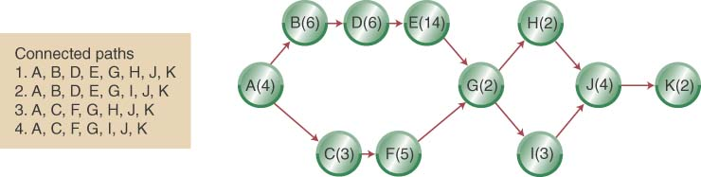
Step 3 (a)- Add Deterministic Time Estimates and Connected Paths

Slide 10
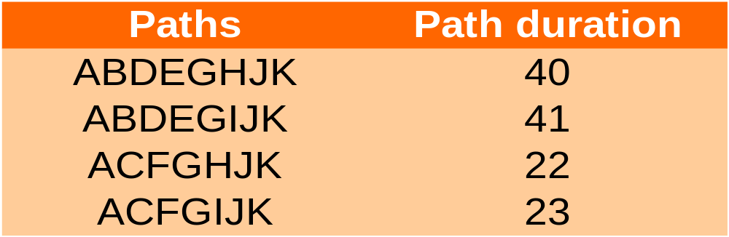
Step 3 (a) (Continued): Calculate the Path Completion Times
The longest path (ABDEGIJK) limits the project’s duration (project cannot finish in less time than its longest path)
ABDEGIJK is the project’s critical path

Slide 11
Some Network Definitions
All activities on the critical path have zero slack
Slack defines how long non-critical activities can be delayed without delaying the project
Slack = the activity’s late finish minus its early finish (or its late start minus its early start)
Earliest Start (ES) = the earliest finish of the immediately preceding activity
Earliest Finish (EF) = is the ES plus the activity time
Latest Start (LS) and Latest Finish (LF) depend on whether or not the activity is on the critical path

Slide 12
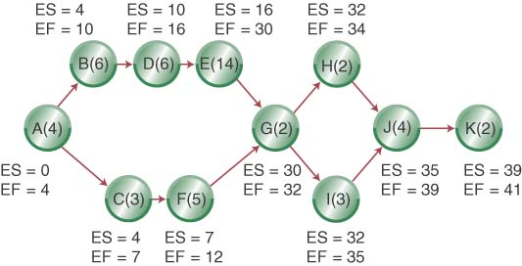
ES, EF Network

Slide 13
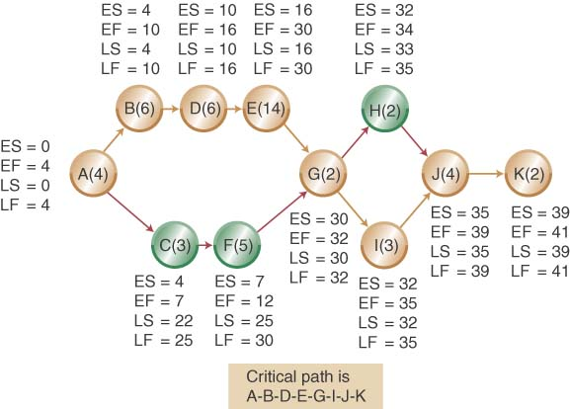
LS, LF Network

Slide 14
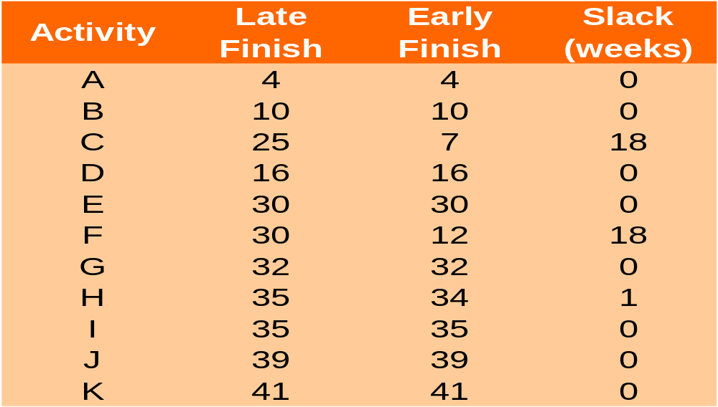
Calculating Slack

Slide 15
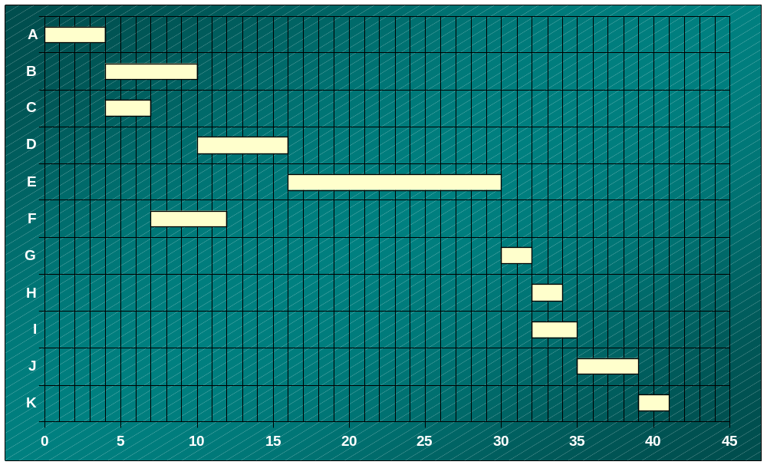
Earliest Start Gantt Chart

Slide 16
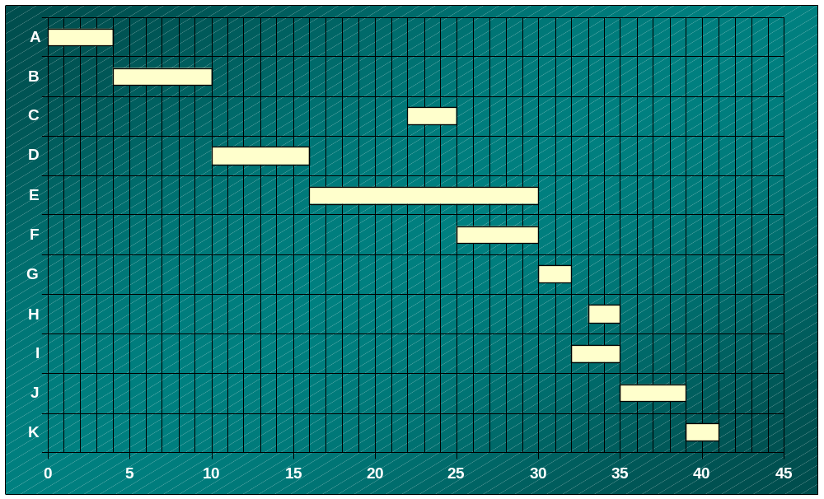
Latest Start Gantt Chart

Slide 17
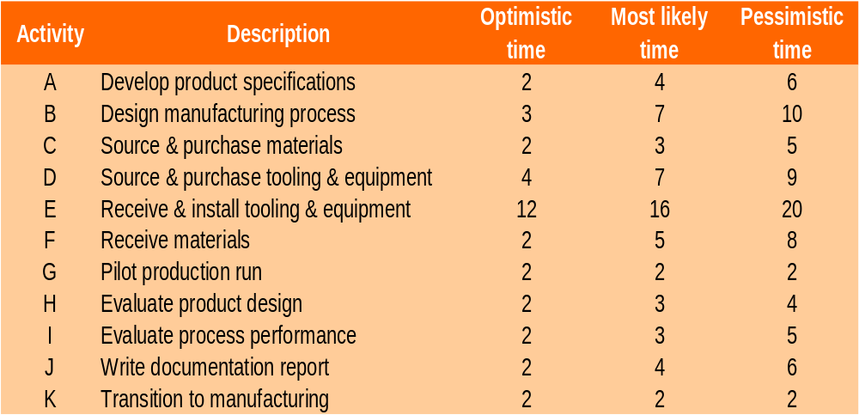
Revisiting Cables By Us Using Probabilistic Time Estimates

Slide 18
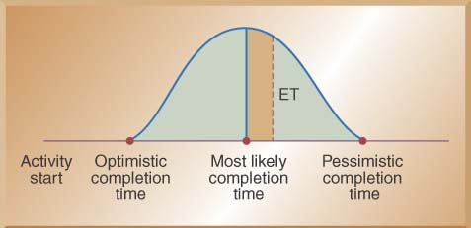

Using Beta Probability Distribution to Calculate Expected Time Durations
A typical beta distribution is shown below, note that it has definite end points
The expected time for finishing each activity is a weighted average

Slide 19

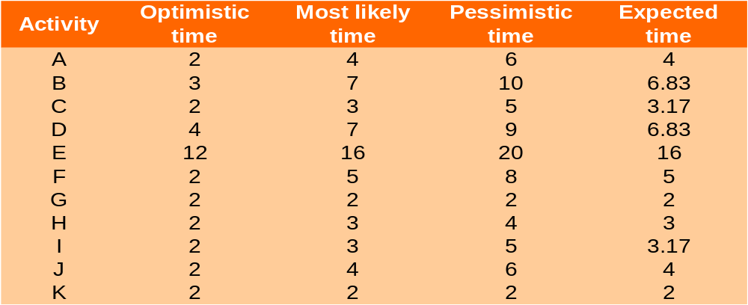
Calculating Expected Task Times

Slide 20
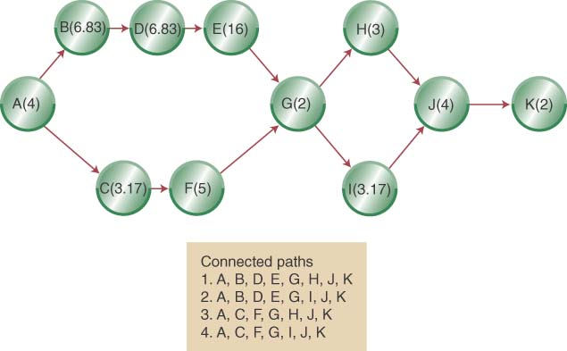
Network Diagram with Expected Activity Times

Slide 21
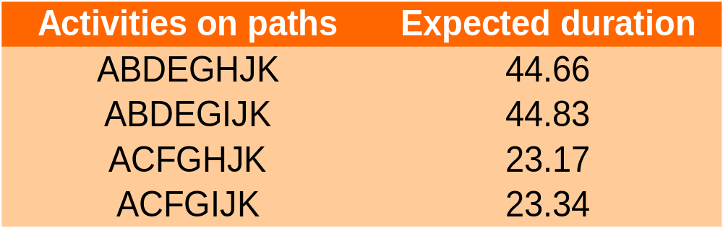
Estimated Path Durations through the Network
ABDEGIJK is the expected critical path & the project has an expected duration of 44.83 weeks

Slide 22
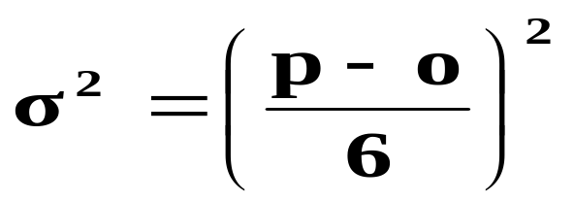
Estimating the Probability of Completion Dates
Using probabilistic time estimates offers the advantage of predicting the probability of project completion dates
We have already calculated the expected time for each activity by making three time estimates
Now we need to calculate the variance for each activity
The variance of the beta probability distribution is:
  where p=pessimistic activity time estimate
o=optimistic activity time estimate

Slide 23
Project Activity Variance
Activity | Optimistic | Most Likely | Pessimistic | Variance
A | 2 | 4 | 6 | 0.44
B | 3 | 7 | 10 | 1.36
C | 2 | 3 | 5 | 0.25
D | 4 | 7 | 9 | 0.69
E | 12 | 16 | 20 | 1.78
F | 2 | 5 | 8 | 1.00
G | 2 | 2 | 2 | 0.00
H | 2 | 3 | 4 | 0.11
I | 2 | 3 | 5 | 0.25
J | 2 | 4 | 6 | 0.44
K | 2 | 2 | 2 | 0.00

Slide 24
Variances of Each Path through the Network
Path Number | Activities on Path | Path Variance (weeks)
1 | A,B,D,E,G,H,J,k | 4.82
2 | A,B,D,E,G,I,J,K | 4.96
3 | A,C,F,G,H,J,K | 2.24
4 | A,C,F,G,I,J,K | 2.38

Slide 25
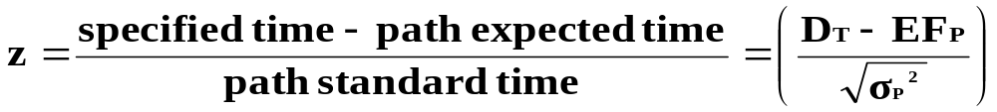

Calculating the Probability of Completing the Project in Less Than a Specified Time
When you know:
  The expected completion time
  Its variance
You can calculate the probability of completing the project in “X” weeks with the following formula:
Where DT = the specified completion date
EFP = the expected completion time of the path

Slide 26
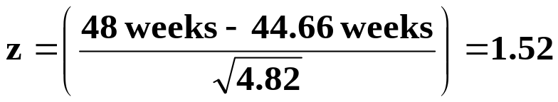
Example: Calculating the probability of finishing the project in 48 weeks
Use the z values in Appendix B to determine probabilities
E.G. for path 1
Path Number | Activities on Path | Path Variance (weeks) | z-value | Probability of Completion
1 | A,B,D,E,G,H,J,k | 4.82 | 1.5216 | 0.9357
2 | A,B,D,E,G,I,J,K | 4.96 | 1.4215 | 0.9222
3 | A,C,F,G,H,J,K | 2.24 | 16.5898 | 1.000
4 | A,C,F,G,I,J,K | 2.38 | 15.9847 | 1.000

Slide 27
Reducing the Time of a Project (crashing)
Activity | Normal Time (wk) | Normal Cost ($) | Crash Time | Crash Cost ($) | Max. weeks of reduction | Reduce cost per week
A | 4 | 8,000 | 3 | 11,000 | 1 | 3,000
B | 6 | 30,000 | 5 | 35,000 | 1 | 5,000
C | 3 | 6,000 | 3 | 6,000 | 0 | 0
D | 6 | 24,000 | 4 | 28,000 | 2 | 2,000
E | 14 | 60,000 | 12 | 72,000 | 2 | 6,000
F | 5 | 5,000 | 4 | 6,500 | 1 | 1500
G | 2 | 6,000 | 2 | 6,000 | 0 | 0
H | 2 | 4,000 | 2 | 4,000 | 0 | 0
I | 3 | 4,000 | 2 | 5,000 | 1 | 1,000
J | 4 | 4,000 | 2 | 6,400 | 2 | 1,200
K | 2 | 5,000 | 2 | 5,000 | 0 | 0

Slide 28
Crashing Example: Suppose the Cables By Us project manager wants to reduce the new product project from 41 to 36 weeks.
Crashing Costs are considered to be linear
Look to crash activities on the critical path
Crash the least expensive activities on the critical path first (based on cost per week)
  Crash activity I from 3 weeks to 2 weeks $1000
  Crash activity J from 4 weeks to 2 weeks $2400
  Crash activity D from 6 weeks to 4 weeks $4000
  Recommend Crash Cost $7400
Will crashing 5 weeks return more than it costs?

Slide 29
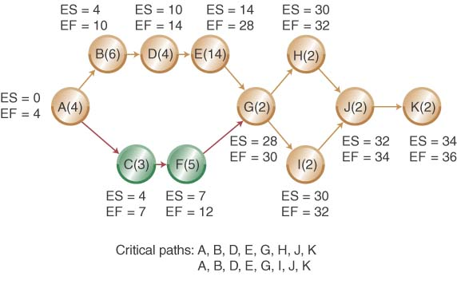
Crashed Network Diagram

Slide 30
Chapter 16 HW Assignment
Problems
1 – 8, 13 - 16

